Slide 1
Working with Key/Value Pairs in Spark : pair RDDs
Presented by
Dr. Latifur Khan
https://www.safaribooksonline.com/library/view/learning-spark/9781449359034/ch04.html

Slide 2
Goal
How to work with RDDs of key/value pairs
Discuss an advanced feature called partitioning
Notes:
How presentation will benefit audience: Adult learners are more interested in a subject if they know how or why it is important to them.
Presenter’s level of expertise in the subject: Briefly state your credentials in this area, or explain why participants should listen to you.

Slide 3
pair RDDs or RDDs containing key/value pairs
commonly used to perform aggregations
Using RDD operations users can act on each key in parallel
Also RDD operations let users regroup data across the network
For Example:
reduceByKey() method that can aggregate data separately for each key
join() method that can merge two RDDs together by grouping elements with the same key
Notes:
Lesson descriptions should be brief.

Slide 4
Creating pair RDDs in Spark
Some return pair RDDs for their key/value data
Otherwise, regular RDD can be turned into a pair RDD by running a map()
Example:
We consider code that starts with an RDD of lines of text and the first word in each line as keys
We will see the code in Python and Scala
Notes:
Lesson descriptions should be brief.

Slide 5
Creating a pair RDD using the first word as the key in Python
In Python, for the functions on keyed data to work we need to return
an RDD composed of tuples
Notes:
Lesson descriptions should be brief.

Slide 6
Creating a pair RDD using the first word as the key in Scala
In Scala, tuples should be returned for the keyed data to be available
An implicit conversion on RDDs of tuples exists to provide the additional key/value
functions.
Notes:
Lesson descriptions should be brief.

Slide 7
Transformations on Pair RDDs
Pair RDDs contain tuples, we need to pass functions that operate on tuples rather than on individual elements
Pair RDDs are allowed to use all the transformations available to standard RDDs
Example: {(1, 2), (3, 4), (3, 6)}
Notes:
Lesson descriptions should be brief.

Slide 8
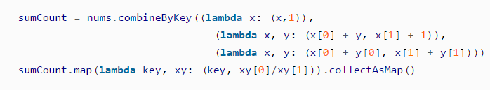
Transformations on Pair RDDs : Example
Function name | Purpose | Example | Result
reduceByKey(func) | Combine values with the same key. | rdd.reduceByKey((x, y) => x + y) | {(1, 2), (3, 10)}
groupByKey() | Group values with the same key. | rdd.groupByKey() | {(1, [2]), (3, [4, 6])}
combineByKey(createCombiner,mergeValue, mergeCombiners,partitioner) | Combine values with the same key using a different result type.
mapValues(func) | Apply a function to each value of a pair RDD without changing the key. | rdd.mapValues(x => x+1) | {(1, 3), (3, 5), (3, 7)}
Per-key average using combineByKey() in Python
Notes:
Lesson descriptions should be brief.

Slide 9
Transformations on Pair RDDs : Example
Function name | Purpose | Example | Result
flatMapValues(func) | Apply a function that returns an iterator to each value of a pair RDD, and for each element returned, produce a key/value entry with the old key. Often used for tokenization. | rdd.flatMapValues(x => (x to 5) | {(1, 2), (1, 3), (1, 4), (1, 5), (3, 4), (3, 5)}
keys() | Return an RDD of just the keys. | rdd.keys() | {1, 3, 3}
values() | Return an RDD of just the values. | rdd.values() | {2, 4, 6}
sortByKey() | Return an RDD sorted by the key. | rdd.sortByKey() | {(1, 2), (3, 4), (3, 6)}
Notes:
Lesson descriptions should be brief.

Slide 10
More on Pair RDDs
Pair RDDs support all the functions supported by simple RDDs
Example:
For the previously used RDD, filter out lines larger than 20 characters
Simple filter on second element in Python
Simple filter on second element in Scala
Notes:
Lesson descriptions should be brief.

Slide 11
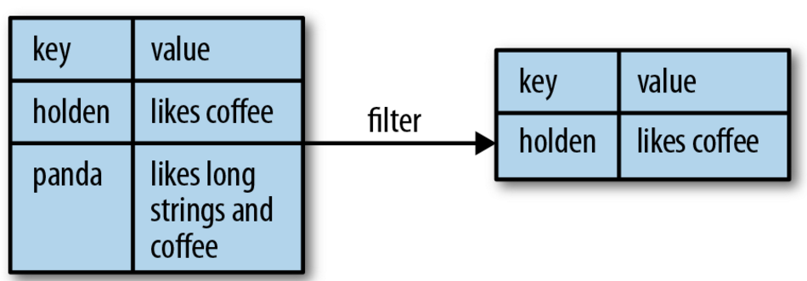
More on Pair RDDs
Pictorial representation of the operation
What if one wants to access the value part of the <Key Value> pair if pair RDDs?
Spark provides mapValues(func) function for that
This function is same as : map{case (x, y): (x, func(y))}
Notes:
Lesson descriptions should be brief.

Slide 12
More on Pair RDDs : Aggregations
Spark has operations for pair RDDs to combine values with the same key, same to those for simple RDDs
Actions for pair RDD | Actions for basic RDD | Use
reduceByKey() | reduce() | take a function and use it to combine values
foldByKey() | fold() | use a zero value of the same type of the data in our RDD and combination function
Notes:
Lesson descriptions should be brief.

Slide 13
reduceByKey()
Runs several parallel reduce operations
One for each key in the dataset, where each operation combines values that have the same key
Returns a new RDD consisting of each key and the reduced value for that key
foldByKey()
Zero should have no impact when added with your combination function to another element
Notes:
Lesson descriptions should be brief.

Slide 14
Code sample for reduceByKey() and mapValues()
rdd.mapValues(lambda x: (x, 1)).reduceByKey(lambda x, y: (x[0] + y[0], x[1] + y[1]))
Per-key average with reduceByKey() and mapValues() in Python
rdd.mapValues(x => (x, 1)).reduceByKey((x, y) => (x._1 + y._1, x._2 + y._2))
Per-key average with reduceByKey() and mapValues() in Scala
Notes:
Lesson descriptions should be brief.

Slide 15
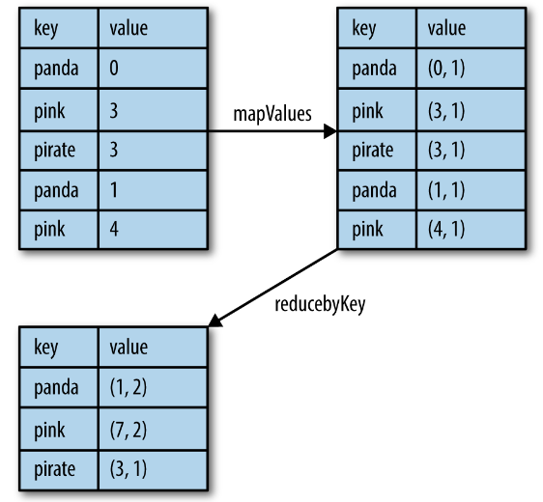
reduceByKey() and mapValues()
Pictorial representation of Per-key average data flow
Notes:
Lesson descriptions should be brief.

Slide 16
Actions Available on Pair RDDs
Function | Description | Example | Result
countByKey() | Count the numberof elements for each key. | rdd.countByKey() | {(1, 1), (3, 2)}
collectAsMap() | Collect the result as a map to provide easy lookup. | rdd.collectAsMap() | Map{(1, 2), (3, 4), (3, 6)}
lookup(key) | Return all values associated with the provided key. | rdd.lookup(3) | [4, 6]

Slide 17
Understanding PageRank algorithm in Scala on Spark
Presented by
Dr. Latifur Khan
http://www.openkb.info/2016/03/understanding-pagerank-algorithm-in.html

Slide 18
Goal
How to understand PageRank algorithm in Scala on Spark.
Each step will be explained using sample data.
Environment
Spark 1.5.2
scala 2.10.4
Notes:
How presentation will benefit audience: Adult learners are more interested in a subject if they know how or why it is important to them.
Presenter’s level of expertise in the subject: Briefly state your credentials in this area, or explain why participants should listen to you.

Slide 19
Algorithm
The PageRank algorithm outputs a probability distribution used to represent the likelihood that a person randomly clicking on links will arrive at any particular page.
Initialize each page’s rank to 1.0.
On each iteration, have page p send a contribution of rank(p)/numNeighbors(p) to its neighbors (the pages it has links to).
Set each page’s rank to 0.15 + 0.85 * contributionsReceived.
The last two steps repeat for several iterations, during which the algorithm will con‐ verge to the correct PageRank value for each page. In practice, it’s typical to run about 10 iterations.
Notes:
Lesson descriptions should be brief.

Slide 20
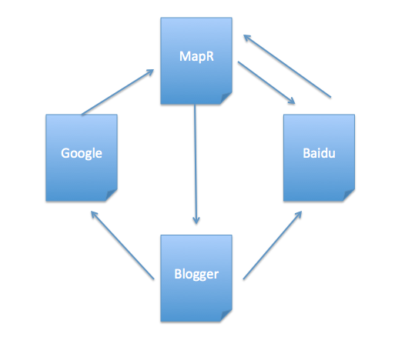
Sample Data:
Above diagram shows there are 4 web pages with theirs outbound & inbound links.
Notes:
Example objectives
At the end of this lesson, you will be able to:
Save files to the team Web server.
Move files to different locations on the team Web server.
Share files on the team Web server.

Slide 21
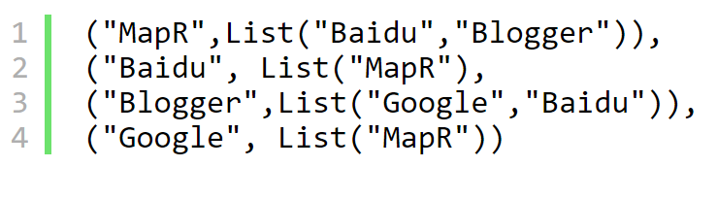
Example (Contd.)
If we consider the outbound links as a data type (String, List(String)), then data should be:

Slide 22
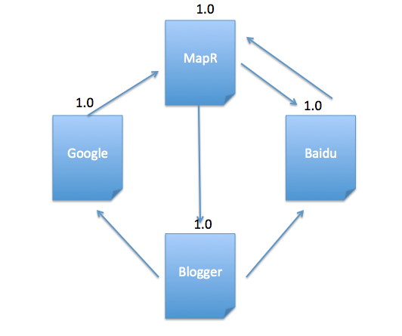
Solution
Initialize each page’s rank to 1.0.
1. val links = sc.parallelize(List(("MapR",List("Baidu","Blogger")),
("Baidu", List("MapR")),("Blogger",List("Google","Baidu")),
("Google", List("MapR")))).partitionBy(new HashPartitioner(4)).persist()
2. var ranks = links.mapValues(v => 1.0)

Slide 23
Solution
On each iteration, have page p send a contribution of rank(p)/numNeighbors(p) to its neighbors (the pages it has links to).
val contributions = links.join(ranks).flatMap { case (url, (links, rank)) =>
links.map(dest => (dest, rank / links.size)) }

Slide 24
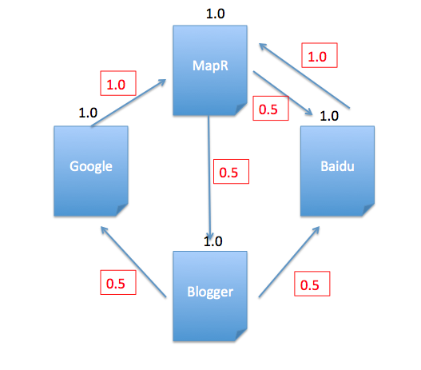
Solution
See contributions in red, and it matches the calculations using scala:
1. scala> contributions.collect
2. res26: Array[(String, Double)] = Array((MapR,1.0), (Baidu,0.5), (Blogger,0.5), (Google,0.5), (Baidu,0.5), (MapR,1.0))

Slide 25
Solution
Set each page’s rank to 0.15 + 0.85 * contributionsReceived.
val ranks = contributions.reduceByKey((x, y) => x + y).mapValues(v => 0.15 + 0.85*v)

Slide 26
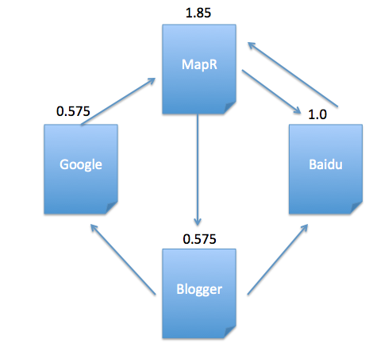
Solution
After 1st iteration, current pagerank value for each page is:
1. scala> ranks.collect
2. res27: Array[(String, Double)] = Array((Google,0.575), (MapR,1.8499999999999999), (Blogger,0.575), (Baidu,1.0))
Then the last two steps repeat for several iterations.

